Slide 1







3D Object Detection with LiDAR-Camera Fusion
PointPillars + ResNet Architecture on KITTI-360 Dataset
FAORO LORENZO
December 8, 2025

Slide 2














Project Overview & Objectives
Main Goal
Architecture
Hybrid deep learning architecture with PointPillars for LiDAR feature extraction and ResNet50 for camera image processing, integrated through a sophisticated fusion module.
Implement a multi-modal 3D object detection system that effectively combines LiDAR point clouds and camera images to increaese perception.
Target Objects
Dataset
Utilize the KITTI-360 autonomous driving dataset, a comprehensive benchmark for urban scene understanding, to train and validate the model.
Cars
Pedestrians
Cyclists
Training Environment
Conduct all training and development within Google Colab, utilizing its GPU acceleration capabilities to manage computational demands.

Slide 3









KITTI-360 Dataset
Data Sources
LiDAR Point Clouds
Sensor: Velodyne HDL-64E laser scanner
Format: 1000 files in .bin format
Density: ~100,000 points per scan
Features: Each point includes (x, y, z, intensity) coordinates
Key Features
Camera Images
Comprehensive urban scene understanding
Sensor: High-resolution RGB cameras
Multimodal sensor data integration
Format: 1000 images in .png format
Rich annotation for 3D object detection
Resolution: 376 x 1408 pixels
Synchronization: Temporally aligned with LiDAR scans
3D Annotations
Format: XML files
Content: 3D bounding boxes with position, size, and orientation,
Categories: Cars, pedestrians, cyclists, and ground elements

Slide 4





















Data Preprocessing Pipeline
LiDAR Input
Camera Input
Binary .bin files with shape (N, 4) representing points as (x, y, z, intensity)
.png image files with shape (3, H, W) in RGB format
MIDDLE-FUSION
Point Cloud Processing
Synchronization
Image Processing
Temporal Alignment: Ensures time correspondence
Resizing: To 256 x 512 pixels
Subsampling: Max 50,000 points per scan
Normalization: Pixel values to [0, 1]
Matching: Based on file indices (e.g., 0000000000 to 0000001000)
Zero-padding: Ensure consistent input size
Channel Ordering: (H, W, C) to (C, H, W)
Normalization: Preserves metric relationships
Preprocessed Output
LiDAR:
Image:
(batch, 50000, 4)
(batch, 3, 256, 512)

Slide 5














LiDAR Backbone - PointPillars
Input
PointPillars Architecture
(x, y, z, intensity)
Simplified for efficient feature extraction from point clouds
Stage 1
Stage 2
Stage 3
Stage 4
Point-wise Feature Extraction
Global Feature Aggregation
Bird's Eye View Generation
2D CNN (convolution net.)Processing
MLP layers with BatchNorm & ReLU
Max pooling across all points
Expands global features to 2D grid
Conv2d(256→512) + BN + ReLU
Captures global scene structure
Conv2d(512→512) + BN + ReLU
Linear(4→64) → Linear(64→256)
Creates pseudo-image representation
One global vector for the feature of
the scene
From 3d to 2d
Process BEV with convolutional net.
Batch Normalization + ReLU to get:
Stability
Faster training
Output: (batch, num_points, 256)
Output: (batch, 256)
Output: (batch, 256, 64, 64)
Output: (batch, 512, 16, 16)
Final Output
(batch, 512, 16, 16)
Compact feature map for fusion with camera data

Slide 6
























Image Backbone - ResNet50
Feature Extraction Pipeline
Feature Characteristics
Input
Multi-scale hierarchical information
(batch, 3, 256, 512) 3=RGB channels; 256 Height; 512 Width
Rich semantic content
Perspective view representation
Initial Convolution
Texture, color, and appearance
7×7 convolution with step of 2p → (batch, 64, 128, 128)
Benefits
Max Pooling
3×3 max pooling with step of 2 → (batch, 64, 64, 128)
Strong initialization from ImageNet
Proven effective architecture
Residual Blocks
Robust feature extraction
Four layers extracting hierarchical features → (batch, 2048, 8, 16)
Channel Reduction
1×1 convolution → (batch, 512, 8, 16)

Slide 7


FusionModule with Attention
STEPS
GOAL: fuse data from lidar and camera in the best possible way
which one makes the correct prediction?
STEP 1 → ALLIGNMENT AND CALIBRATION of the two types of lidar and camera data
STEP 2→ 32x32 grid containing 512 lidar features (info) and 512 camera features
STEP 3 → ATTENTION MECHANISM the network learns if trust to the camera or the lidar most
STEP 4 → WEIGHTED FUSION application of different weight to the features
STEP 5 → FINAL FUSION middle-fusion with attention

Slide 8









Detection Head Architecture
Multi-Task Architecture
The detection head processes fused features to predict object classifications, 3D bounding box parameters, and object directions.
Classification Branch
3D Bounding Box Regression
Direction Classification
Conv2d(256 → 3, )
Conv2d(256 → 7, )
Conv2d(256 → 2, )
Predicts class probabilities for Car, Pedestrian, Cyclist
Predicts 7 parameters: (x, y, z, l, w, h, θ)
(boxes position and orientation)
Binary classification to disambiguate object orientation
(if it’s front or back oriented)
Detection Process
Dense prediction over 32×32 grid in BEV Bird's Eye View space

Slide 9





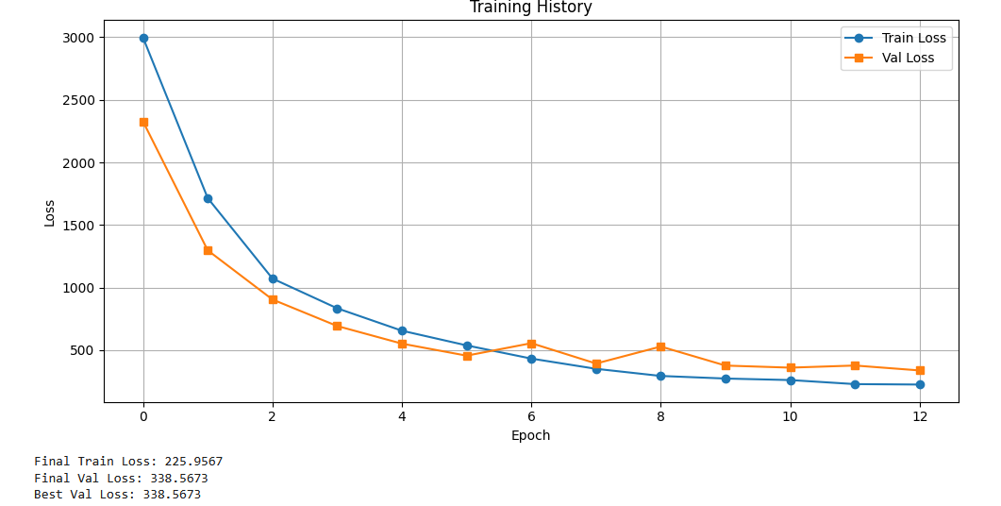







Training Strategy & Setup
Training Configuration
Training Process
Framework & Hardware
Learning Rate Schedule
PyTorch 2.0 on Google Colab GPU
Data Parameters
Batch Size: 4 | Training Samples: 800 | Validation Samples: 200 | Epochs: 13
Multi-Task Loss Function
Ltotal = Lclassification + Lregression + 0.2 × Ldirection
Binary Cross Entropy standard
Smooth L1
regression bbox
Cross Entropy
Best Val Loss: 338
Best Train Loss: 226
3 classes (pedestrian…)
σ=3.0
Weight: 0.2
Prediction vs reality
Underfitting?

Slide 10
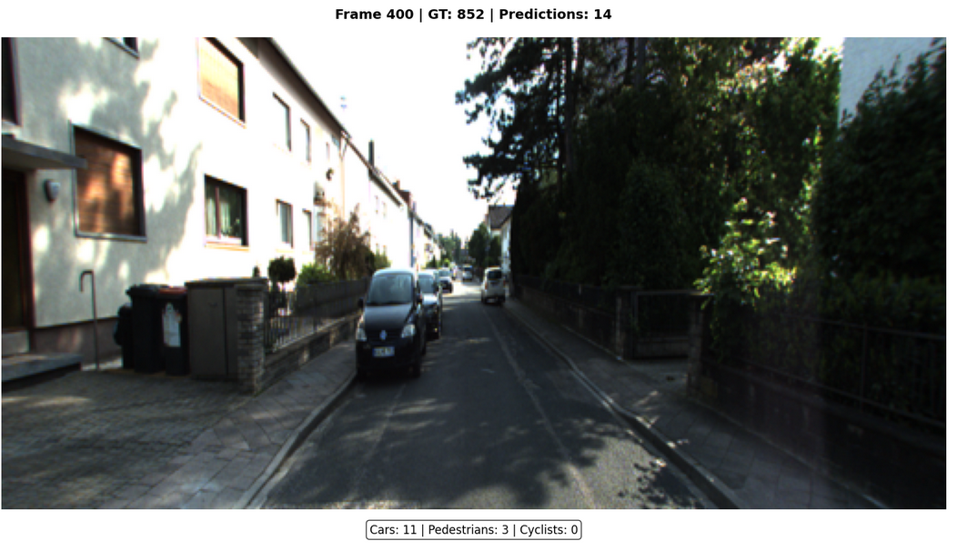
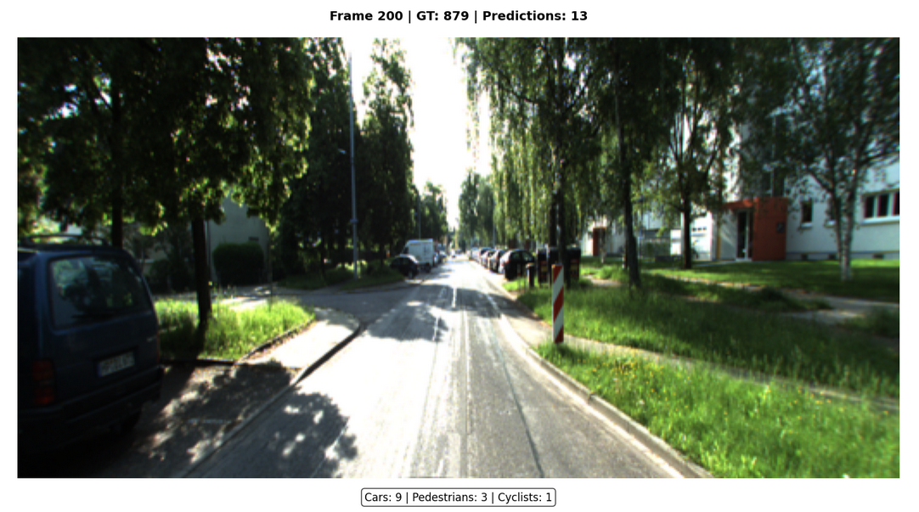
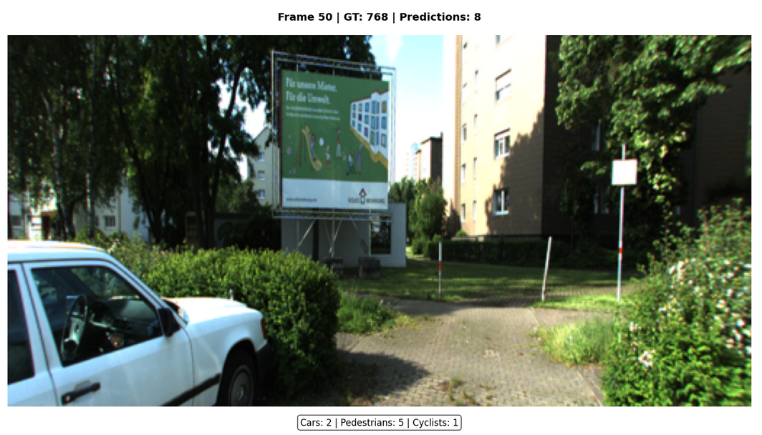
Training Results
The basic problems certainly lie in the simplicity of the model, the low number of samples analyzed, the underfitting
→Detection of pedestrians and cyclists is very imprecise

Slide 11





Conclusion
Key Achievements
Current Limitations
Successfully implemented PointPillars + ResNet fusion architecture
Implementation parameter calibration
Overfitting - underfitting
Trained on KITTI-360 dataset with 1000 multi-modal samples
Achieved stable training with decreasing loss curves
Small dataset size (1000 samples)
Created an end-to-end pipeline from raw data to a trained model
Demonstrated the utility of LiDAR-Camera fusion for 3D detection
The confidence in detecting pedestrians and bikes is lower than that of machines. During training there are few scenes of pedestrians and bikes, I think this is the main cause.
FRAME 200 OBJECTS: 11cars, 0 pedestrian, 0 cyclists →

